Slide 1
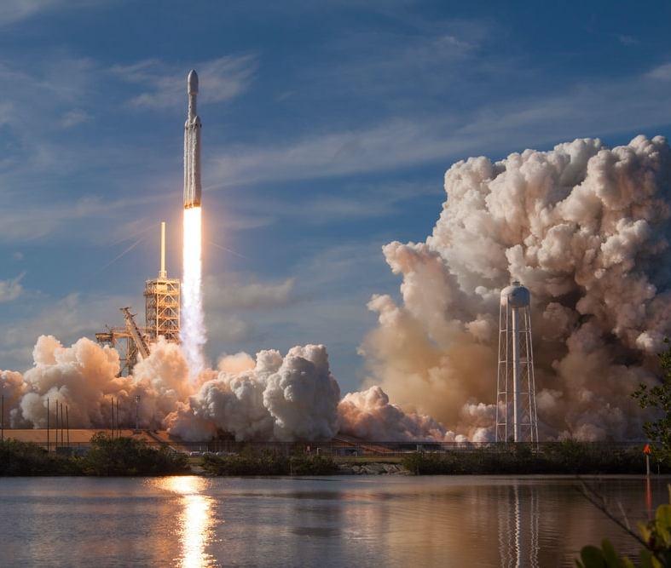
SpaceX Falcon 9 First Stage Landing Prediction
By: Imaduddin Sheikh
1/7/2021

Slide 2

Outline
Summary
Introduction
Methodology
Results
Conclusion
Appendix

Slide 3
Executive Summary
Summary of methodologies
Data Collection
Data Wrangling
Explanatory Data Analysis with Data Visualization
Explanatory Data Analysis with SQL
Building an interactive map with Folium
Building a dashboard with Plotly Dash
Predictive Analysis (Classification)
Summary of all results
Explanatory data analysis results
Screenshots of interactive analytics demonstration
Predictive analysis results

Slide 4
Introduction
Most commercial space companies spend up to $165 million per rocket launch
SpaceX, with their flagship Falcon 9 rocket, have cut this cost down to an estimation of $62 million per rocket launch
HOW?
By reusing Stage One, which is a large and expensive component of the rocket, the recovery of Stage One means drastic decrease in manufacturing costs.
Of course, successful Stage One recovery is NOT guaranteed!
The outcome of the launch has a significant impact on the overall cost of the launch.

Slide 5
Introduction
The Capstone project in the Applied Data Science course by IBM consisted of building machine learning prediction models that would predict whether a SpaceX Stage One recovery will be successful or not.
An alternate company can use this knowledge if it wants to bid against SpaceX for a rocket launch.
Common Problems that need solving
What factors influence successful Stage One landing?
Effect of each variable on the success rate of a successful landing
Conditions needed to achieve the best results and ensure optimal landing success rate

Slide 6


Slide 7
Methodology
Executive Summary
Data collection methodology:
SpaceX REST API
Web Scraping (from Wikipedia)
Perform data wrangling (Data Preprocessing)
Performing statistics on collected data and implementation of One-Hot Encoding on variables for further analysis
Perform exploratory data analysis (EDA) using visualization and SQL
Plotting of graphs to show relationships of data fields on the success of a landing

Slide 8
Methodology
Executive Summary - Continued
Perform interactive visual analytics using Folium and Plotly Dash
Creation of markers on an interactive map and dashboard to visualize relationships of variables to recovery outcomes
Perform predictive analysis using classification models
Creation of various machine-learning models and fine-tuning hyperparameters to provide the most accurate outcome

Slide 9
Data Collection
The following datasets was collected by:
We worked with SpaceX launch data that is gathered from the SpaceX REST API.
This API will give us data about launches, primarily, the information about the rocket used, payload delivered, launch specifications, landing specifications.
Our goal is to use this data to predict whether SpaceX will attempt to land a rocket or not.
The SpaceX REST API endpoints, or URL, starts with api.spacexdata.com/v4/.
Another popular data source for obtaining Falcon 9 Launch data is web scraping Wikipedia using BeautifulSoup, which gave us the landing outcome as well as some additional information about the launches. Data from both sources are combined to form a uniform dataset.
SpaceX API
Web Scraping (Wikipedia)
Use SpaceX REST API
API returns SpaceX data in .json format
Normalize data in flat data file such as .csv
Use SpaceX REST API
API returns SpaceX data in .json format
Normalize data in flat data file such as .csv

Slide 10
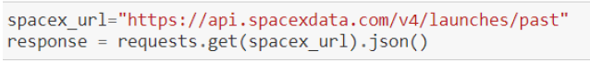
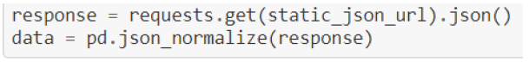
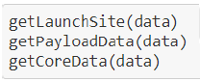
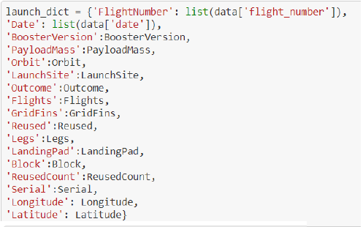
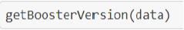
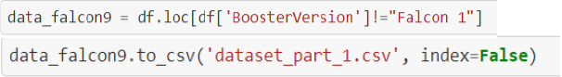
Data Collection – SpaceX API
1. Getting response from API
2. Converting response to a .json file
Data Wrangling
3. Apply custom functions to clean data
4. Assign list to dictionary then data frame
API returns SpaceX data in .json
Use SpaceX REST API
Filter DF for Falcon 9 only/Clean data
5. Filter data frame and export to flat file (.csv)
Normalize data into flat file such as .csv
GitHub Link to Notebook

Slide 11
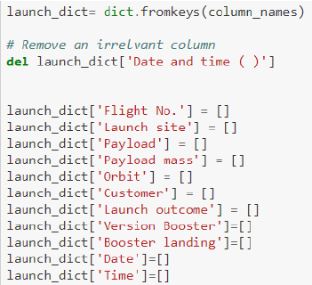
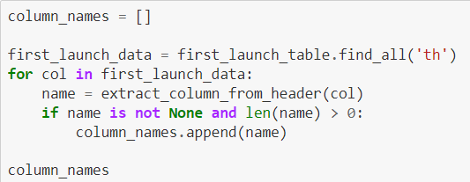
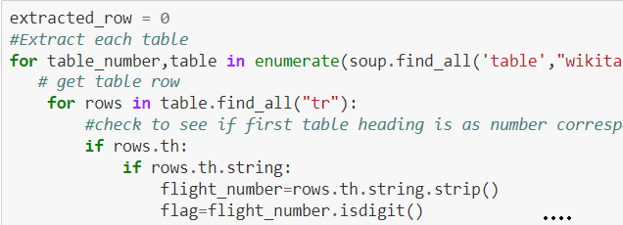
Data Collection – Web Scraping
1. Getting response from API
5. Creation of dictionary
Data Wrangling
2. Creating BeautifulSoup object
3. Finding tables
4. Getting columns names
API returns SpaceX data in .json
Extract data using BeautifulSoup
Filter DF for Falcon 9 only/Clean data
6. Appending data to keys
8. Normalize data frame to flat .csv file
7. Converting dictionary to data frame
Normalize data into flat file such as .csv
GitHub Link to Notebook

Slide 12
GitHub Link to Notebook
Data Wrangling
Introduction
In the data set, there were several cases where the booster did not land successfully
Sometimes, a landing was attempted but failed due to an accident.
According to the data collected, there were 8 outcomes that we could classify as a Success or Failure:
True ASDS → Successful landing to drone ship
True RTLS → Successful landing on a ground pad
True Ocean → Successful landing in ocean
None None → Failed to land
None ASDS → Failed to land
False ASDS → Failed to land on drone ship
False RTLS → Failed to land on ground
False Ocean → Failed to land in ocean

Slide 13
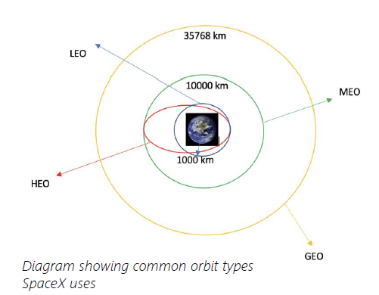
Data Wrangling
From here, we could create a new column, ‘class’, to delineate between successful and unsuccessful recoveries, and will then perform EDA.
0 – Unsuccessful recovery
1 – Successful recovery
Each launch aims to a dedicated orbit. Here are some orbit types:
Calculate the number of launches on each site
Create a landing outcome label, ‘class’ from ‘Outcome’ column
Calculate number and occurrence of mission outcome per orbit type
Calculate number and occurrence of mission outcome per orbit type

Slide 14
GitHub Link to Notebook
EDA with Data Visualization
Scatter plots drawn for relationship(s) between:
Flight Number vs Payload Mass
Flight Number vs Launch Site
Payload Mass vs Launch Site
Orbit vs Flight Number
Payload vs Orbit Type
Orbit vs Payload Mass
Bar plot drawn for relationship between:
Mean vs Orbit
A bar diagram makes it easy to compare sets of data between different groups briefly. The graph represents categories on one axis and a discrete value in the other. The goal is to show the relationship between the two axes. Bar charts can also show big changes in data over time.
Line graph drawn for relationship between:
Success Rate vs Year
Scatter plots show how much one variable is affected by another. The relationship between two variables is called their correlation. Scatter plots usually consist of a large body of data.
Line graphs are useful in that they show data variables and trends very clearly and can help to make predictions about the results of data not yet recorded.

Slide 15

GitHub Link to Notebook
EDA with SQL
Performed SQL queries to gather information about the dataset.
For example, of some questions we were asked about the data we needed information about. Which we are using SQL queries to get the answers in the dataset :
Displaying the names of the unique launch sites in the space mission
Displaying 5 records where launch sites begin with the string 'KSC’
Displaying the total payload mass carried by boosters launched by NASA (CRS)
Displaying average payload mass carried by booster version F9 v1.1
Listing the date where the successful landing outcome in drone ship was achieved.
Listing the names of the boosters which have success in ground pad and have payload mass greater than 4000 but less than 6000
Listing the total number of successful and failure mission outcomes
Listing the names of the booster versions which have carried the maximum payload mass.
Listing the records which will display the month names, successful landing outcomes in ground pad ,booster versions, launch site for the months in year 2017
Ranking the count of successful landing outcomes between the date 2010-06-04 and 2017-03-20 in descending order.

Slide 16
GitHub Link to Notebook
Build an Interactive Map with Folium
To visualize the Launch Data into an interactive map.
We took the Latitude and Longitude Coordinates at each launch site and added a Circle Marker around each launch site with a label of the name of the launch site.
We assigned the data frame launch outcomes(failures, successes) to classes 0 and 1.
The Green and Red markers on the map in a MarkerCluster() correspond to successful and unsuccessful recoveries respectively.
Using Haversine’s formula we calculated the distance from the Launch Site to various landmarks.
Lines are drawn on the map to measure distance to landmarks. The distance calculated was used to find various trends about what is around the Launch Site to measure patterns.
Example of some trends in which the Launch Site is situated in.
Are launch sites in close proximity to railways? No
Are launch sites in close proximity to highways? No
Are launch sites in close proximity to coastline? Yes
Do launch sites keep certain distance away from cities? Yes

Slide 17

Link to Plotly Dashboard
Build a Dashboard with Plotly Dash
Dashboard source code
The dashboard is deployed live on Heroku for audience and interested parties.
The dashboard utilized Flask and Dash web framework for deployment.
In the dashboard:
Pie Chart visualizes the relative proportion of the launches’ success with respect to the launch sites.
Scatter Plot shows the relationship with Outcome and Payload Mass (Kg) for the different Booster Versions, as well as the spread of the variables for their corresponding outcomes.

Slide 18
GitHub Link to Notebook
Predictive Analysis (Classification)
For each of the following models:
Logarithmic Regression
Support Vector Machines
Decision Tree
KNN
Standardize the data
Split data into train/test portions
Use Scikit-learn method ‘GridSearchCV’ to find best parameters
Fit models with training data using best hyperparameters
Test model using testing data, compute accuracy score and plot Confusion matrix

Slide 19
Results
Exploratory data analysis results
SpaceX has gotten better at launching rockets overtime. Launches are most successful when launched in 2017 or later
Light payloads are evidently easier to recover, as most successful recoveries occur when the payload has a mass between 2000kg and 4000kg)
Each launch site is reasonably successful, but site KSC LC-39A appears to be ideal as it has a success rate of over 75%
The best recovery method appears to be via drone ships. This would make sense as SpaceX has much more control over the recovery maneuvering a ship in the ocean as opposed to a stationary landing pad on land.
Interactive analytics demo in screenshots
The demo can be accessed by visiting the dashboard via the link provided in the ‘Build a Dashboard with Plotly Dash’ presentation slide, or Section 5 of the presentation.

Slide 20
Results
Predictive analysis results
Each model performed about equally, correctly predicting a recovery outcome at a rate of 83.33%.

Slide 21


Slide 22
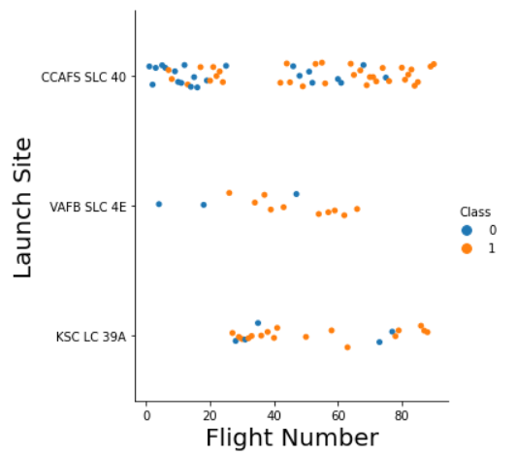
Flight Number vs. Launch Site
Success rate has grown over time at each site, though KSC LC-39A seems to be the most consistent.

Slide 23
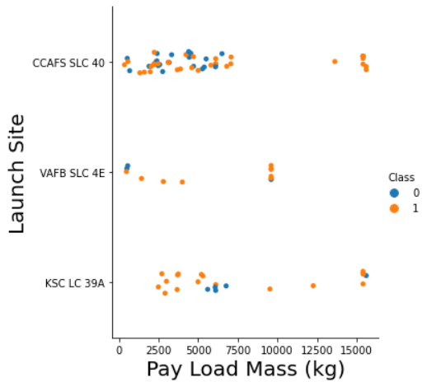
Payload vs. Launch Site
Launch Site CCAFS SLC 40 has experienced higher success rate as the payload mass increases. However, there is still not a clear pattern decide if the Launch Site is dependent on payload mass for a successful launch.
For the VAFB-SLC launch site, there are no rockets launched for heavy payload mass(greater than 10000).

Slide 24
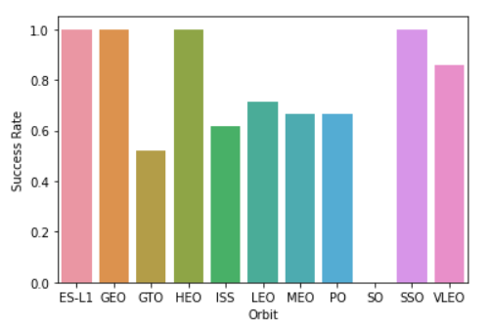
Success Rate vs. Orbit Type
Orbits ES-L1, GEO, HEO and SSO have the highest Success Rate

Slide 25
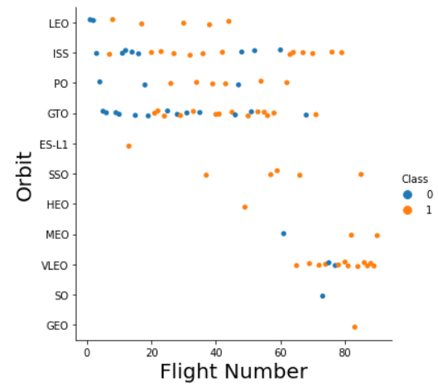
Flight Number vs. Orbit Type
LEO orbit the Success appears related to the number of flights; on the other hand, there seems to be no relationship between flight number when in GTO orbit.
However, ES-L1, HEO, and GEO success rate may be skewed due to each having only 1 launch.
LEO, SSO, and VLEO seem all have high success rates while having high sample sizes.

Slide 26
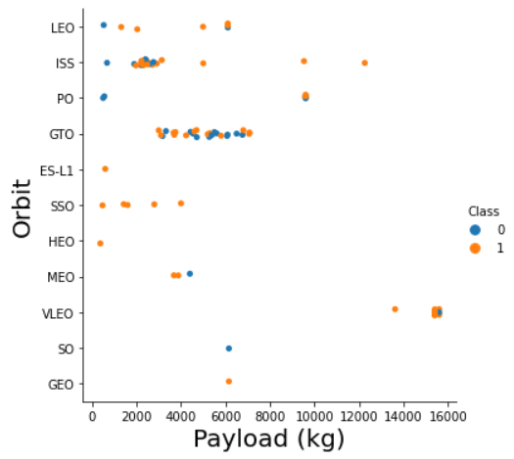
Payload vs. Orbit Type
With heavier payloads, the odds for successful landing are greater for Polar, LEO and ISS.
However, for GTO we cannot distinguish this well as both positive landing rate and negative landing(unsuccessful mission) are both there here.
LEO and SSO orbits’ success may be due to light payloads.

Slide 27
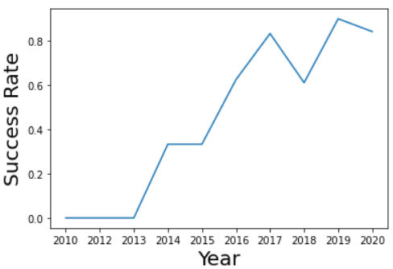
Launch Success Yearly Trend
There is overall increase in success rate from 2013 till 2020. However, there was stagnation between the years 2017 and 2019.

Slide 28
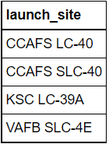
All Launch Site Names
SQL Query
Query Explanation
Using the word DISTINCT in the query means that
it will only show unique values in the launch_Site
column from SPACEXDATASET.
Query Result

Slide 29
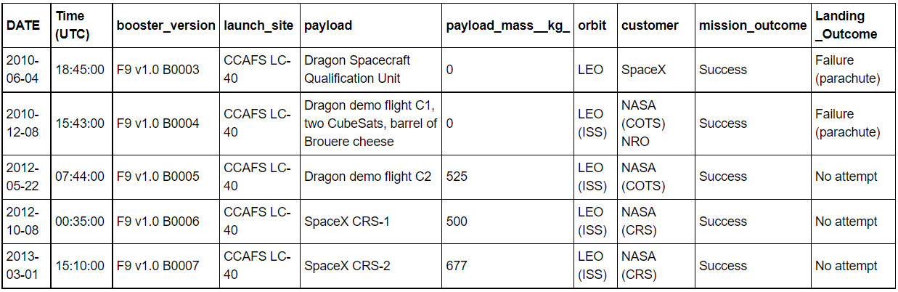
Launch Site Names Begin with 'CCA'
SQL Query
Query Result
Query Explanation
Using the word LIMIT 5 in the query means that it will only show 5 records from SPACEXDATASET and LIKE keyword has a wild card with the words
‘CCA%’ the percentage in the end suggests that the launch_site name must start with CCA.

Slide 30
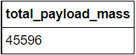
Total Payload Mass
SQL Query
Query Explanation
Using the function SUM summates the total in
the column payload_mass__kg_. The WHERE
clause filters the dataset to only perform
calculations on Customer NASA (CRS).
Query Result

Slide 31
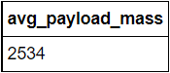
Average Payload Mass by F9 v1.1
SQL Query
Query Explanation
Using the function AVG works out the
average in the column payload_mass__kg_.
The WHERE clause filters the dataset to
only perform calculations on booster_version
F9 v1.1 at the start.
Query Result

Slide 32
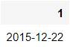
First Successful Ground Landing Date
SQL Query
Query Explanation
Using the function MIN works out the minimum
date in the column Date. The WHERE clause filters
the dataset to only perform calculations on
Landing _Outcome (landing outcome column) which
contains value representing successful landing on ground
- Success (ground pad).
Query Result

Slide 33
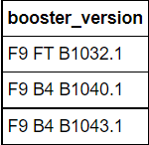
Successful Drone Ship Landing with Payload between 4000 and 6000
SQL Query
Query Explanation
The query selects only booster_version from SPACEXDATASET, then
uses the WHERE clause to filter the dataset such that
‘Landing _Outcome’(landing outcome column) contains the value
Success (drone ship), and at the same time meets the requirement
that payload_mass__kg_ is between 4000 and 6000 exclusive.
Query Result

Slide 34
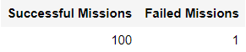
Total Number of Successful and Failure Mission Outcomes
SQL Query
Query Explanation
This query has two subqueries concatenated. The first
subquery constructs a column that only contains the number
of mission outcomes that were a success, and the second
subquery constructs a column that only contains the number
of mission outcomes that were a failure.
Query Result

Slide 35
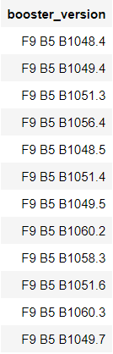
Boosters Carried Maximum Payload
Query Result
SQL Query
Query Explanation
The query selects the booster_version from the
SPACEXDATASET where the payload mass value
(in payload_mass__kg_ column) meets the maximum payload
mass requirement.

Slide 36
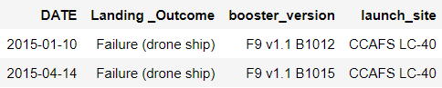
2015 Launch Records
SQL Query
Query Explanation
This query selects the required data fields
from the records which match the condition
of have a failed outcome (via drone ship)
in the year of 2015.
Query Result

Slide 37
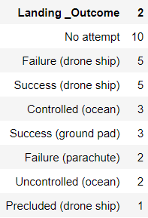
Rank Landing Outcomes Between 2010-06-04 and 2017-03-20
SQL Query
Query Explanation
This query outputs, in descending order, the Landing Outcome
column and a counter column for those records whose
date is between 2010-06-04 and 2017-03-20.
Query Result

Slide 38


Slide 39
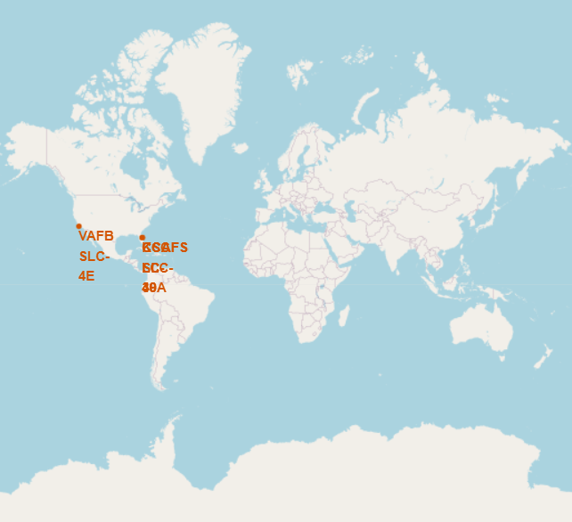
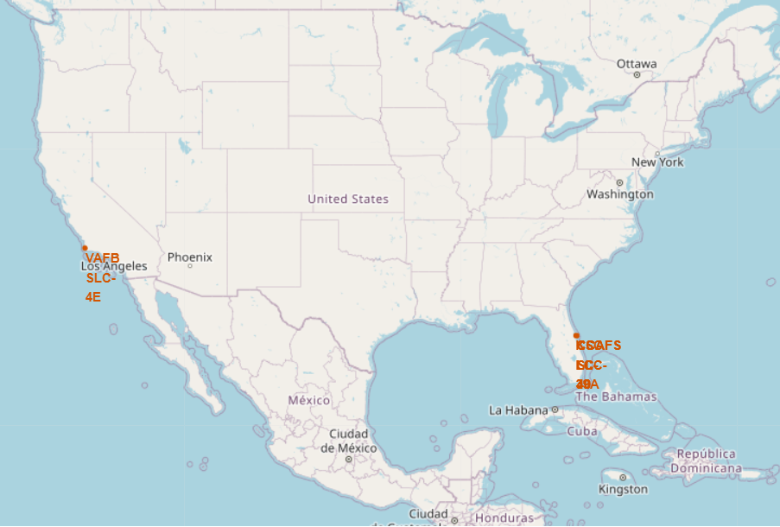
SpaceX Launch Site Locations
It can be deduced from the map generated by Folium
all launch sites are present in the United States primarily
in the coastal areas of Florida and California.

Slide 40
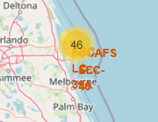
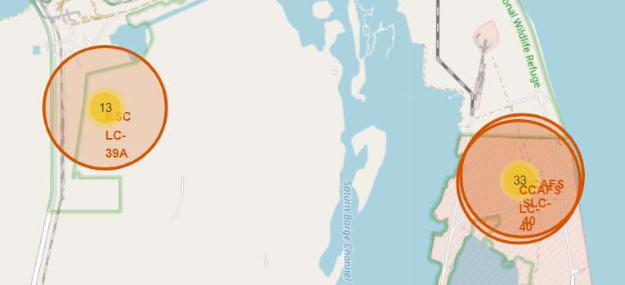
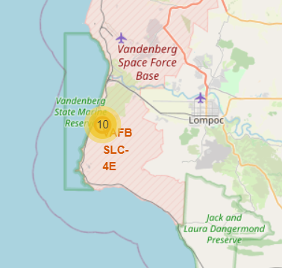
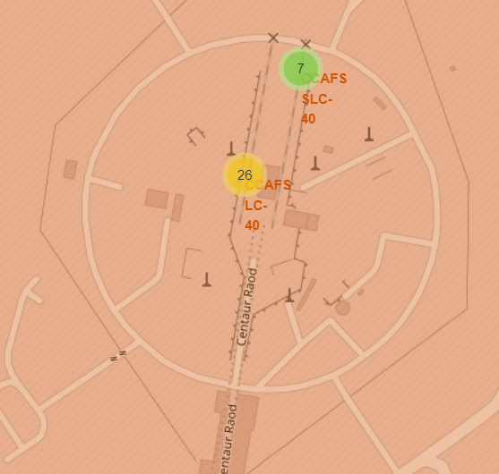
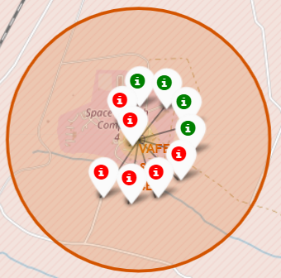
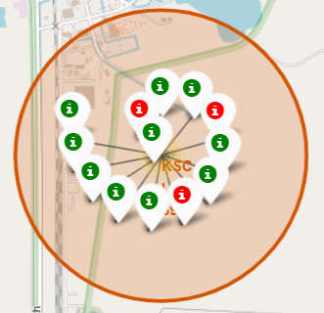
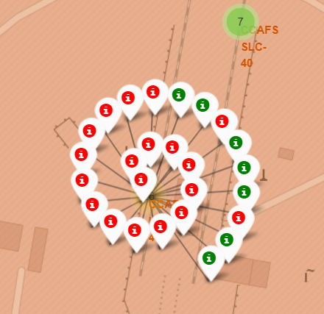
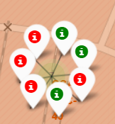
Color Labelled Launch Records
Florida launch sites
California launch site
One launch site situated on the Pacific coast of southern California.
Three launch sites are situated on the Atlantic coast of Florida.
Marker colors:
Green = Success
Red = Failure
VAFB SLC-4E
KSC LC-39A
CCAFS LC-40
CCAFS LC-40

Slide 41
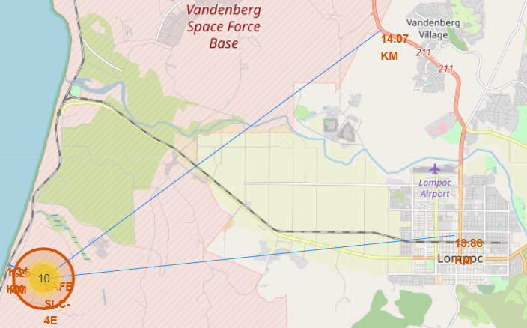
Launch Site Hotspot Proximity
California Launch Site - VAFB SLC-4E
Each blue line represents the distance to the nearest:
- coastline
city/town
railway
highway
Notes:
Reasonable distance from closest city and highway (both ~14km)
Very close to coast and nearest railway (both <2km)

Slide 42
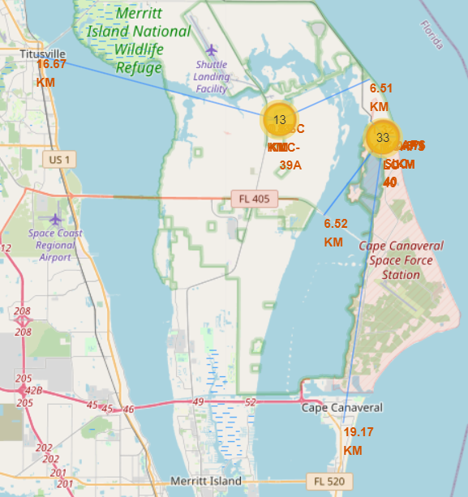
Launch Site Hotspot Proximity
Florida Launch Sites - CCAFS LC-40, CCAFS SLC-40, and KSC LC-39A
Notes:
Reasonable distance to nearest towns (>15km)
Launch sites located very close to coast and surprisingly close to railways and highways (<7km)

Slide 43


Slide 44
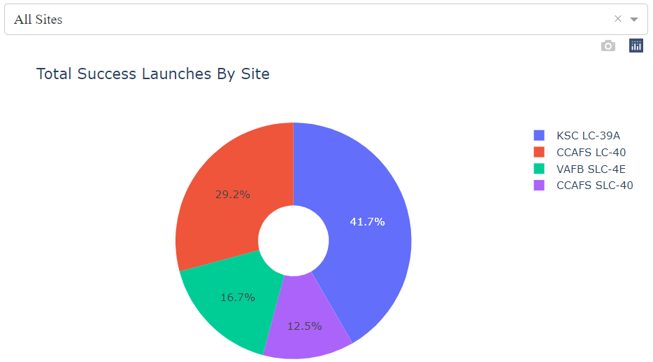
Total Successful Launches by Site
The pie chart visualizes how each launch site’s success fared with one another. KSC LC-39A had the highest successful launches.

Slide 45
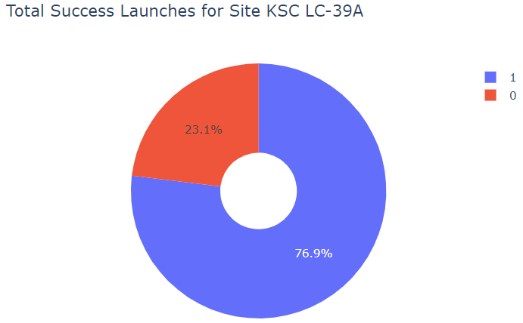
Launch Site with Highest Success Ratio
The pie chart shows that KSC LC-39A achieved a 76.9% success rate while getting a 23.1% failure rate.

Slide 46
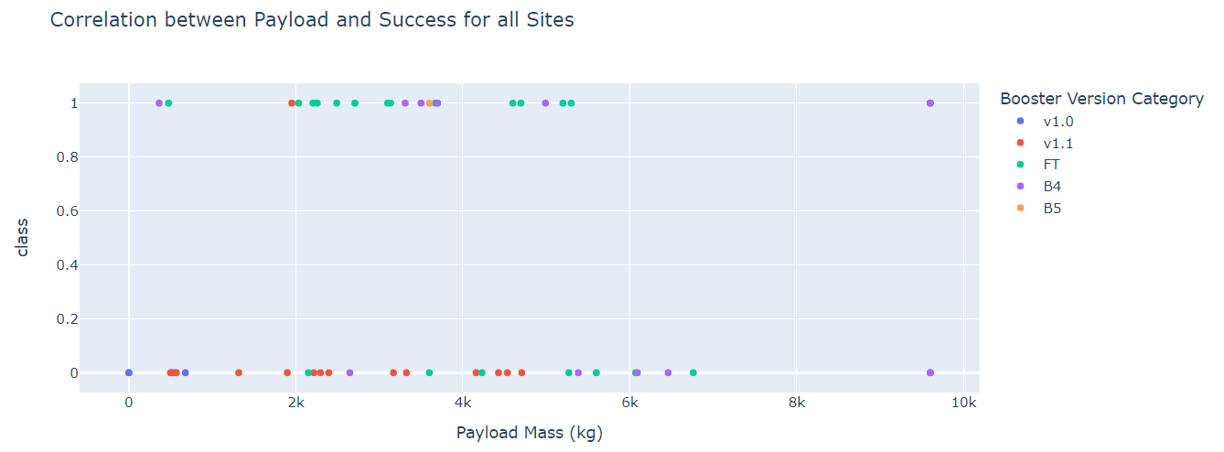
Payload vs. Launch Outcome For All Sites
The most successful payload range appears to be from 2000-4000 kg
The v1.1 booster seems to have failed the most while the FT booster appears to be very successful

Slide 47


Slide 48
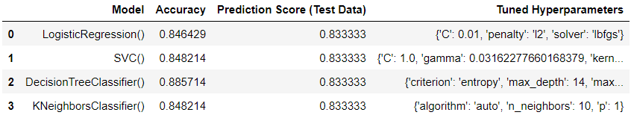
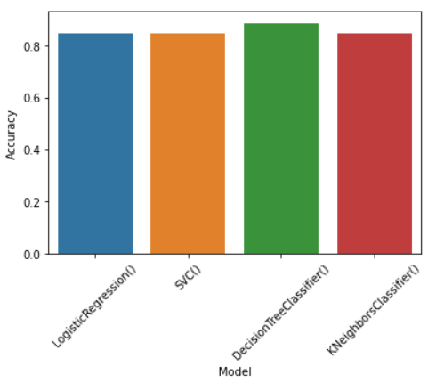
Classification Accuracy
The Decision Tree model demonstrates an accuracy of 88.57%,
with a score of 83.33% on the test data.
Hence, the Decision Tree classifier model shall be considered
as the most accurate model.
All models have similar prediction score of 83.33% after hyperparameter-tuning.

Slide 49

Confusion Matrix
The Decision Tree model is mostly accurate, however it wrongly predicted three landings as being successful where they were not. (False Positive)

Slide 50

Conclusions
The Decision Tree Classifier Algorithm is the best for Machine Learning for this dataset.
Low weighted payloads perform better than the heavier payloads.
The success rates for SpaceX launches is directly proportional time in years they will eventually perfect the launches.
We can see that KSC LC-39A had the most successful launches from all the sites.
Orbits GEO,HEO,SSO,ES-L1 has the best Success Rate.

Slide 51
Appendix
Heroku Deployment

Slide 52

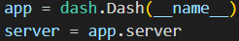
Link to Plotly Dashboard
Link to configuration files
Heroku Deployment
Objective
The visual analytics dashboard created from Plotly Dash was deployed live on the
World Wide Web using the Heroku service.
Process
Extra files had to be created: Procfile, runtime.txt, requirements.txt and some additional code snippets in the app.py file responsible for launching the dashboard.
Pricing
Free, however, a user is only limited to involve 5 sites to his account.

Slide 53


